Slide 1


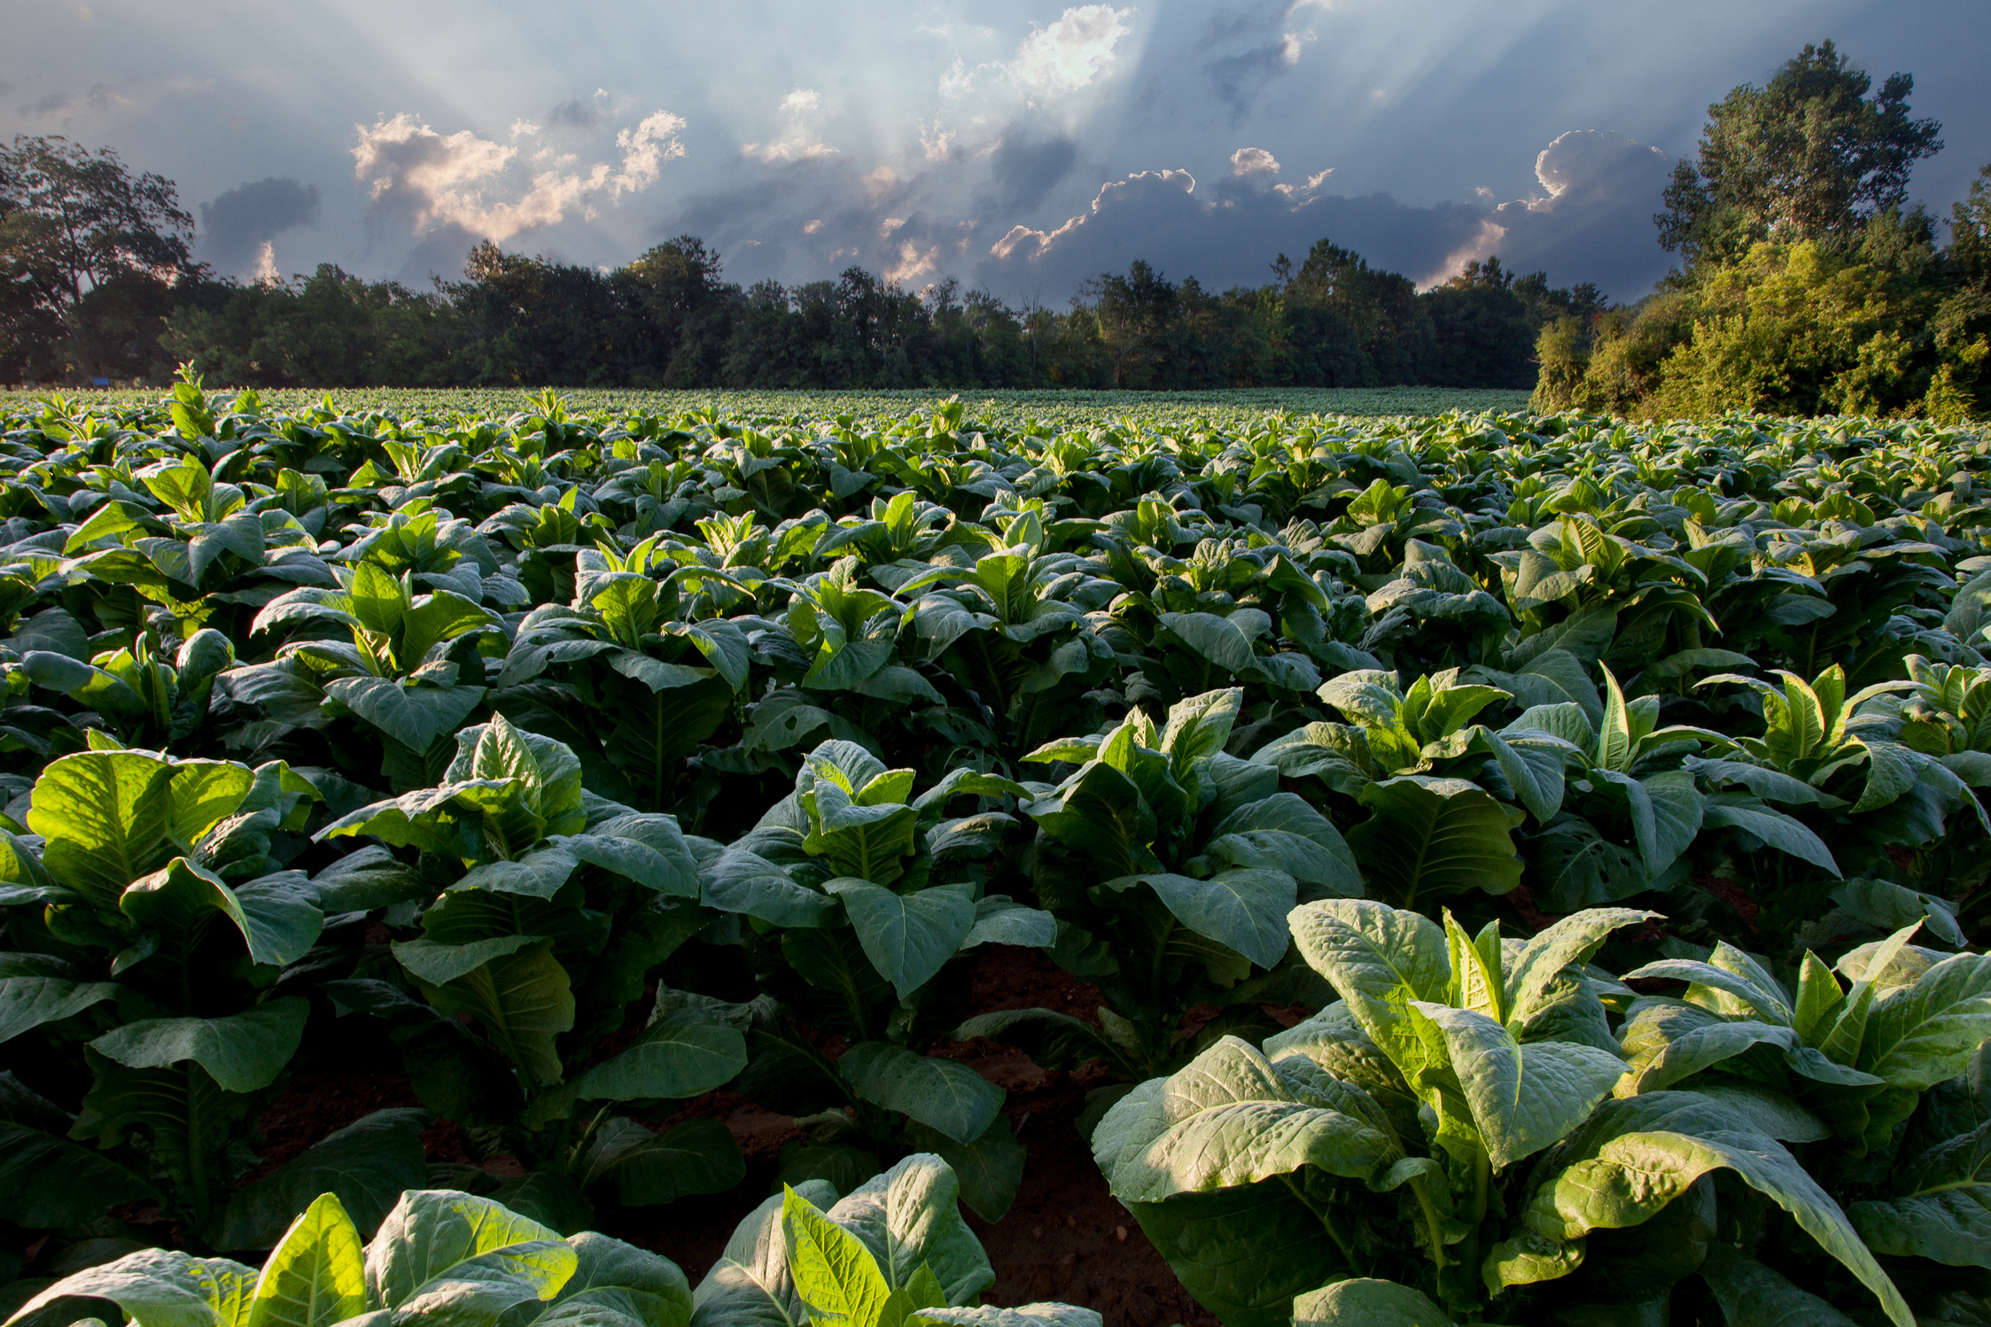


KARAMOJA PROJECT PRESENTATION
Growing Tomorrow's Harvest Today
Presented by
Sosnes Onduru

Slide 2



Page 01
Introduction
Company Name
:
Karamoja
Location
:
Uganda
Key Products
:
Maize and Sorghum
The Karamoja sub-region, commonly known as Karamoja, is a region in Uganda. It covers an area of 27,528km and comprises the Kotido District, Kaabong District, Karenga District, Nabilatuk District, Abim District, Moroto District, Napak District, Amudat District and Nakapiripirit District.This area drew attention on the agricultural radar due to famine and it was a pleasure to come up with ways of rehabilitating the land which later on helped people and even the country at large
Mission Statement
:

Slide 3
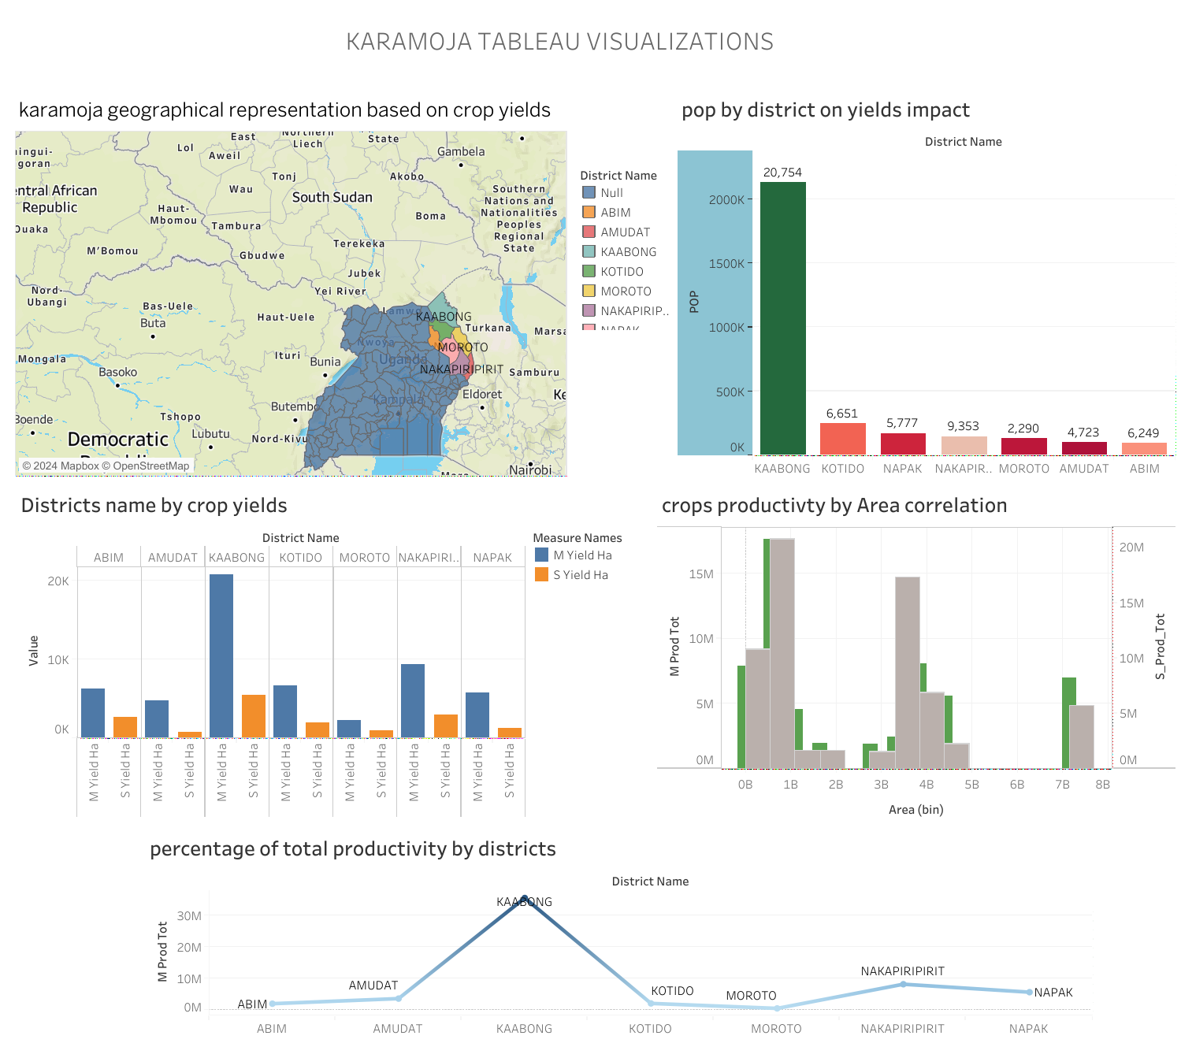

Slide 4

Our Farming Practices
solution
Findings
Recommendations
We came to a realisation that the cultivation of Maize and sorghum would work best in the Karamoja sub_region;ths is because the tw o can wisthstand hostile weather conditions thus boosting their yields.
I recommend the cultivation of maize in the region since it bears more yields than sorghum.The cultivation of maize in the region would not only impact the region but also the whole of Uganda as a nation.
I would give an advice that maize and sorghum be grown in large scale since they do well;the government of Uganda should also allocate more fundss in the agricultural sector;this will help in purchasing improvised farm tools that will help in boosting the yields.

Slide 5
CONCLUSION
The main function of the Karamoja project was to create more crop yields and even to come up with even more drought resistant crops that will help in boosting the agricultural sectorin the country.The project was also based on creating employments for people so as to enable them earn a living and skills that they can also apply on their farms.This project will help in the growth of Uganda make it to be recognised amongst other nations.

Slide 6




Future Outlook
FUTURE GOALS
The main aim of the project was to make Karamoja and Uganda as a whole to be tremendous

Slide 7


Contact Information
Contact:0700862954
Emaiil:ondurusosnes45@gmail.com
THANK YOU!

